Slide 1
Getting start with Node-RED

Slide 2
什麼是 Node-RED?
Node-RED 是 IBM 以 Node.js 為基礎而開發出來的視覺化 IOT 開發工具.

Slide 3
安裝 Node-Red
安裝
sudo apt-get install python-rpi.gpio
sudo apt-get install node.js nodered
sudo reboot
啟動/停止
node-red-start / node-red-stop
會開啟 Port 1880
自動開機啟動
sudo systemctl enable nodered.service

Slide 4
連結 Node-Red
使用 PC Chrome/IE 連線到 RPi
http://raspberrypi.local:1880/
使用 VNC 連結到 RPi
在 RPi 中 Chrome 連結 http://localhost:1880/

Slide 5
Node-Red with RPi - RPIO

Slide 6
Node-Red GPIO Functions

Slide 7
RPI.GPIO out

Slide 8
Inject messages

Slide 9
Inject Messages

Slide 10
Deploy

Slide 11
Run

Slide 12
Debug your flow

Slide 13
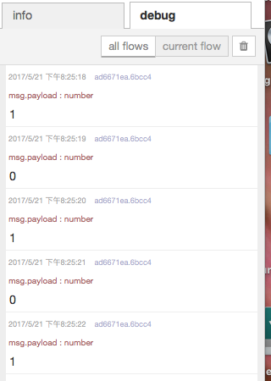
Debug

Slide 14
Add a button
LED: GPIO pin 17
button: GPIO pin 4

Slide 15
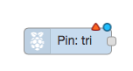
GPIO-In

Slide 16
use Button to control LED

Slide 17
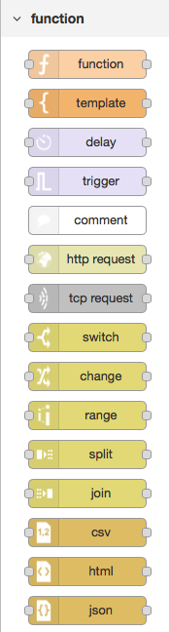
Switch

Slide 18
Switch Node

Slide 19
Add Change Node

Slide 20
Deploy

Slide 21
Add another Change node

Slide 22
CHECK Point 1
Push the button and see the result

Slide 23
Read MCS Cloud data from Node-Red

Slide 24
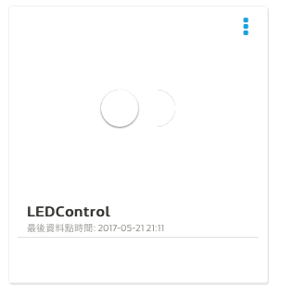
Goal: Read a control LEDControl from MCS Cloud

Slide 25
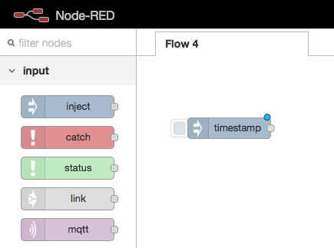
Step 1: Inject

Slide 26
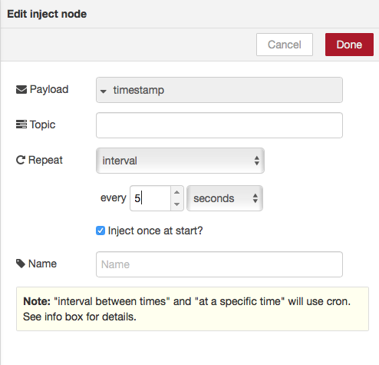

Slide 27
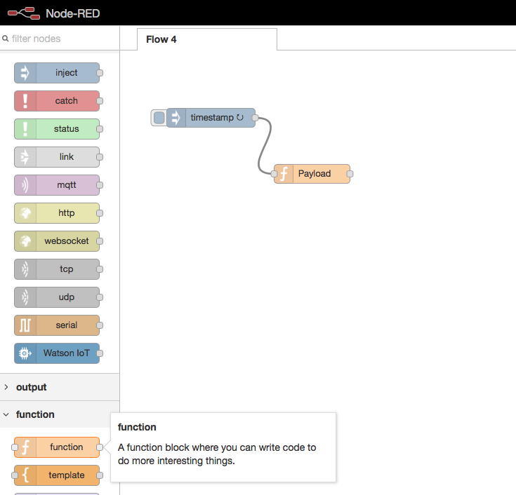
Step 2: Add function

Slide 28
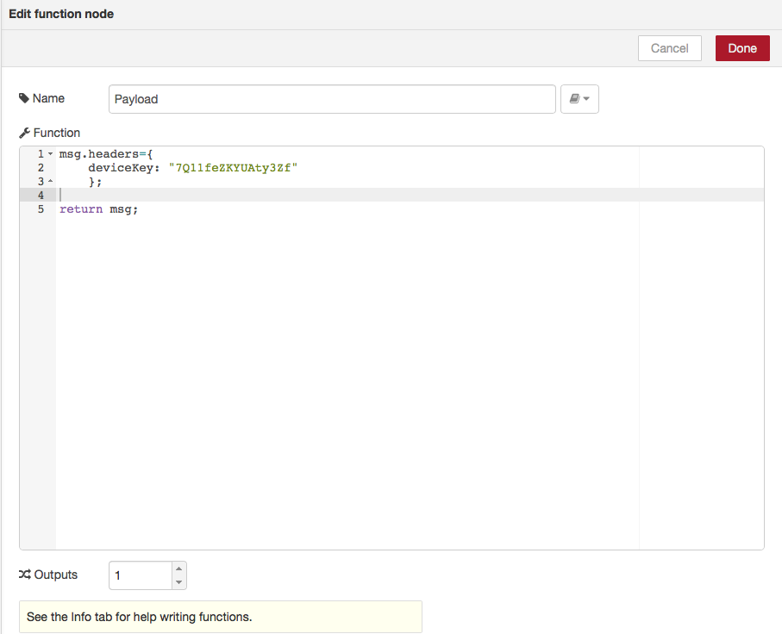
Modify DeviceKey

Slide 29
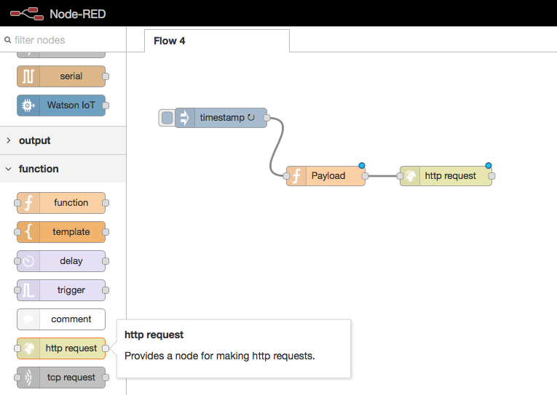
Step 3: HTTP request

Slide 30
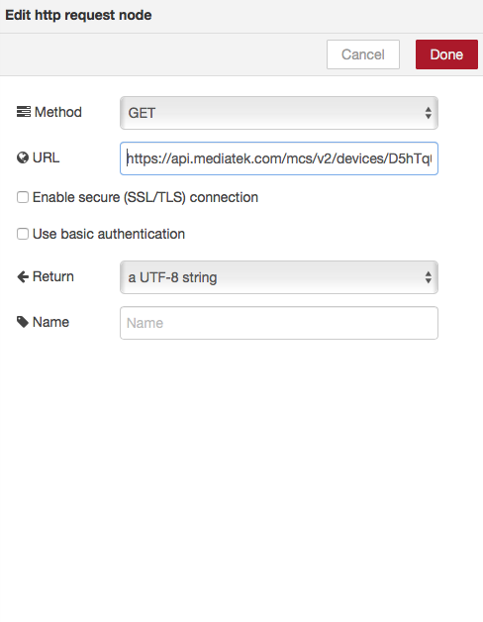
Change deviceID & data channel
http://api.mediatek.com/mcs/v2/devices/DeviceID/datachannels/DataChannelID/datapoints.csv

Slide 31
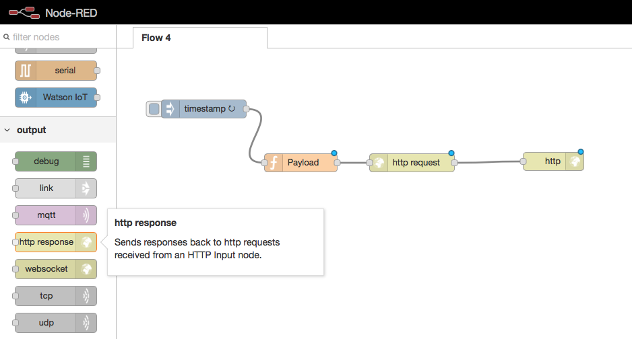
Step 4: add HTTP response

Slide 32
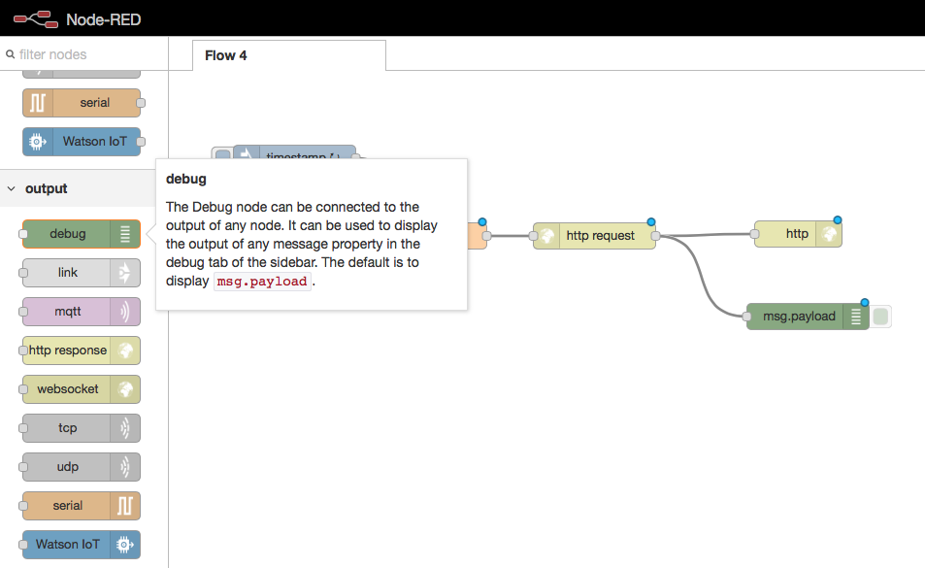
Step 5: add debug

Slide 33
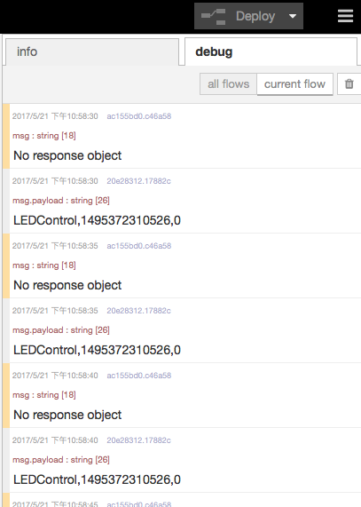
Step 6: Deploy

Slide 34
CHECK POINT2
修改 DataChannel, 由 Node-Red 讀取溫濕度感應器之數值

Slide 35
Modify MCS Cloud Data Channel with Node-Red

Slide 36
Step 1: Inject

Slide 38
Step 2: Add function

Slide 39
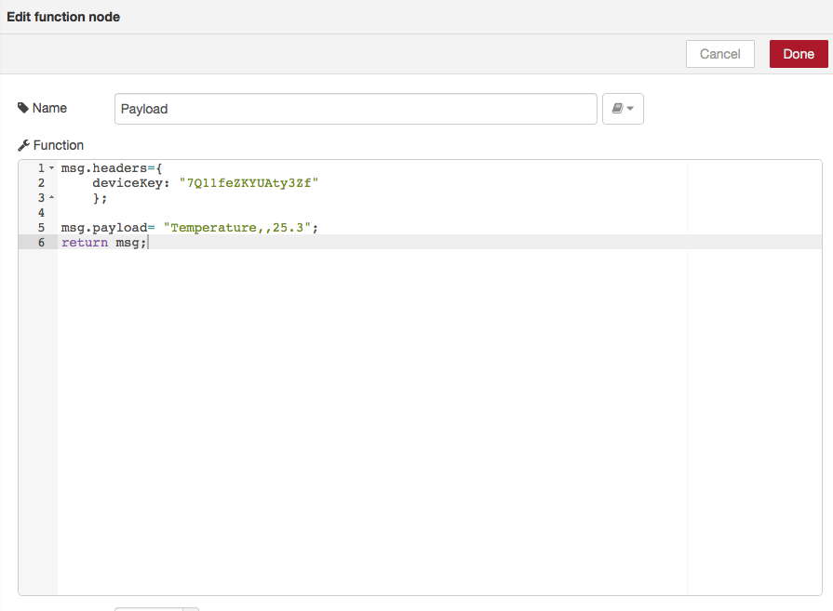
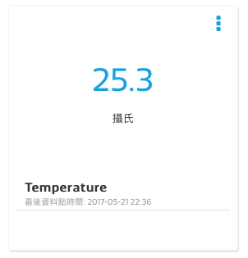
Modify DeviceKey & DataChannel ID

Slide 40
Step 3: HTTP request

Slide 41
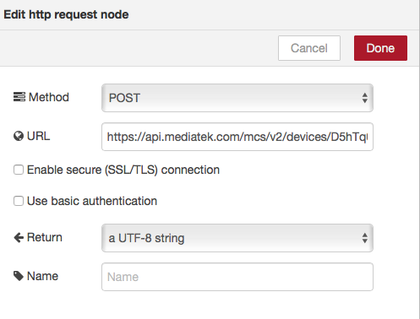
Modify deviceID
URL: https://api.mediatek.com/mcs/v2/devices/deviceID/datapoints.csv

Slide 42
Step 4: add HTTP response

Slide 43
Step 5: add debug

Slide 44
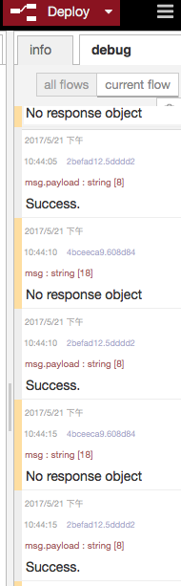
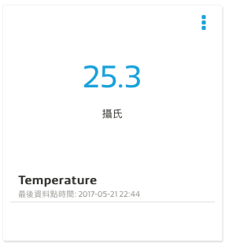
Check debug messages & MCS Cloud

Slide 45
CHECK POINT3
修改 DataChannel, 由 Node-Red 同時設定溫濕度感應器之數值

